Slide 1
Chapter 5
How to code control structures

Slide 2
Objectives (part 1)
Applied
Given a Boolean expression and the values for the variables in the expression, evaluate the expression.
Use if statements, switch statements, and switch expressions as needed within your applications.
Use while, do-while, and for statements as needed within your applications.
Knowledge
Compare the if-else and switch statements.
Compare the if-else statement and the conditional operator.
Describe the differences between while, do-while, and for loops.
Explain how the break and continue statements work when used within a loop.

Slide 3
Objectives (part 2)
Describe the use of breakpoints, the Locals window, and stepping through code as they apply to debugging errors within loops.
Describe block scope in the context of the control structures.

Slide 4
Relational operators
Operator Name
== Equality
!= Inequality
> Greater than
< Less than
>= Greater than or equal
<= Less than or equal

Slide 5
Examples that use relational operators
firstName == "Frank" // equal to a string literal
txtYears.Text == "" // equal to an empty string
message == null // equal to a null value
discountPercent == 2.3 // equal to a numeric literal
isValid == false // equal to the false value
code == productCode // equal to another variable
lastName != "Jones" // not equal to a string literal
years > 0 // greater than a numeric literal
i < months // less than a variable
subtotal >= 500 // greater than or equal to // a literal value
quantity <= reorderPoint // less than or equal to a variable

Slide 6
Logical operators
Operator Name Description
&& Conditional-And Returns a true value if both expressions are true. Only evaluates the second expression if necessary.
|| Conditional-Or Returns a true value if either expression is true. Only evaluates the second expression if necessary.
& And Returns a true value if both expressions are true. Always evaluates both expressions.
| Or Returns a true value if either expression is true. Always evaluates both expressions.
! Not Reverses the value of the expression.

Slide 7
Examples of logical operators
subtotal >= 250 && subtotal < 500
timeInService <= 4 || timeInService >= 12
isValid == true & counter++ < years
isValid == true | counter++ < years
date > startDate && date < expirationDate || isValid == true
((thisYTD > lastYTD) || empType=="Part time") && startYear < currentYear
!(counter++ >= years)

Slide 8
The syntax of the if-else statement
if (booleanExpression) { statements }
[else if (booleanExpression) { statements }] ...
[else { statements }]
If statements without else if or else clauses
With a single statement
if (subtotal >= 100)
discountPercent = .2m;
With a block of statements
if (subtotal >= 100)
{
discountPercent = .2m;
status = "Bulk rate";
}

Slide 9
An if statement with an else clause
if (subtotal >= 100)
discountPercent = .2m;
else
discountPercent = .1m;
An if statement with else if and else clauses
if (subtotal >= 100 && subtotal < 200)
discountPercent = .2m;
else if (subtotal >= 200 && subtotal < 300)
discountPercent = .3m;
else if (subtotal >= 300)
discountPercent = .4m;
else
discountPercent = .1m;

Slide 10
Nested if statements
if (customerType == "R")
{
if (subtotal >= 100) // begin nested if
discountPercent = .2m;
else
discountPercent = .1m; // end nested if
}
else // customerType isn't "R"
discountPercent = .4m;

Slide 11
The syntax of the switch statement
switch (matchExpression)
{
case constantExpression:
statements
break;
[case constantExpression:
statements
break;] ...
[default:
statements
break;]
}

Slide 12
A switch statement with a default label
switch (customerType)
{
case "R":
discountPercent = .1m;
break;
case "C":
discountPercent = .2m;
break;
default:
discountPercent = .0m;
break;
}

Slide 13
A switch statement that falls through the first case label
switch (customerType)
{
case "R":
case "C":
discountPercent = .2m;
break;
case "T":
discountPercent = .4m;
break;
}

Slide 14
The syntax of the switch expression
matchExpression switch
{
constantExpression => expression
[, constantExpression => expression]...
[, _ => expression]
};
A switch expression that uses a discard
discountPercent = customerType switch
{
"R" => .1m,
"C" => .2m,
_ => .0m
};

Slide 15
A switch expression with two cases that return the same result
discountPercent = customerType switch
{
"R" => .2m,
"C" => .2m,
"T" => .4m
};
A switch expression with expressions that perform a calculation
discountAmount = customerType switch
{
"R" => subtotal * .2m,
"C" => subtotal * .2m,
"T" => subtotal * .4m,
_ => .0m
};

Slide 16
A switch expression with relational operators (C# 9.0 and later)
discountAmount = subtotal switch
{
>= 50.0m and <= 200.0m => subtotal * .2m,
> 200.0m => subtotal * .4m,
};

Slide 17
The syntax for a conditional expression
booleanExpression ? trueExpression : falseExpression
A conditional expression
subtotal >= 100 ? .1m : .05m // returns .1 or .05 depending on subtotal

Slide 18
How to use a conditional operator to set the value of a variable
decimal discountPercent = subtotal >= 100 ? .1m : .05m;
A statement that uses parentheses to identify the Boolean expression
decimal discountPercent = (subtotal >= 100) ? .1m : .05m;
An if statement that performs the same task
decimal discountPercent;
if (subtotal >= 100)
discountPercent = .1m;
else
discountPercent = .05m;

Slide 19
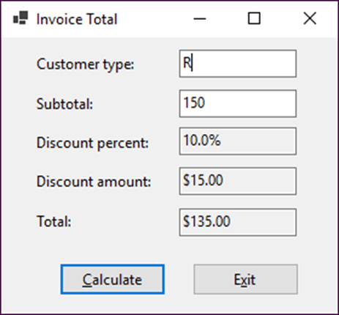
The enhanced Invoice Total form

Slide 20
The event handler for the Click event of the Calculate button (part 1)
private void btnCalculate_Click(object sender, EventArgs e)
{
string customerType = txtCustomerType.Text;
decimal subtotal = Convert.ToDecimal(txtSubtotal.Text);
decimal discountPercent = .0m;
if (customerType == "R")
{
if (subtotal < 100)
discountPercent = .0m;
else if (subtotal >= 100 && subtotal < 250)
discountPercent = .1m;
else if (subtotal >= 250)
discountPercent =.25m;
}
else if (customerType == "C")
{
if (subtotal < 250)
discountPercent = .2m;
else
discountPercent = .3m;
}

Slide 21
The event handler for the Click event of the Calculate button (part 2)
else
{
discountPercent = .4m;
}
decimal discountAmount = subtotal * discountPercent;
decimal invoiceTotal = subtotal - discountAmount;
txtDiscountPercent.Text = discountPercent.ToString("p1");
txtDiscountAmount.Text = discountAmount.ToString("c");
txtTotal.Text = invoiceTotal.ToString("c");
txtCustomerType.Focus();
}

Slide 22
The syntax of the while statement
while (booleanExpression)
{
statements
}
A while loop that adds the numbers 1 through 4
int i = 1, sum = 0;
while (i < 5)
{
sum += i;
i++;
}
A while loop that calculates a future value
int i = 1;
while (i <= months)
{
futureValue = (futureValue + monthlyPayment) *
(1 + monthlyInterestRate);
i++;
}

Slide 23
The syntax of the do-while statement
do
{
statements
}
while (booleanExpression);
A do-while loop that calculates a future value
int i = 1;
do
{
futureValue = (futureValue + monthlyPayment) *
(1 + monthlyInterestRate);
i++;
}
while (i <= months);

Slide 24
The syntax of the for statement
for (initializationExpression; booleanExpression;
incrementExpression)
{
statements
}
A for loop that stores the numbers 0 through 4 in a string
With a single statement
string numbers = null;
for (int i = 0; i < 5; i++)
numbers += i + " ";
With a block of statements
string numbers = null;
for (int i = 0; i < 5; i++)
{
numbers += i;
numbers += " ";
}

Slide 25
A for loop that adds the numbers 8, 6, 4, and 2
int sum = 0;
for (int j = 8; j > 0; j-=2)
{
sum += j;
}
A for loop that calculates a future value
for (int i = 1; i <= months; i++)
{
futureValue = (futureValue + monthlyPayment) *
(1 + monthlyInterestRate);
}

Slide 26
A loop with a break statement

Slide 27
A loop with a continue statement
The result of this loop
1
2
3
4
Big
5
Big

Slide 28
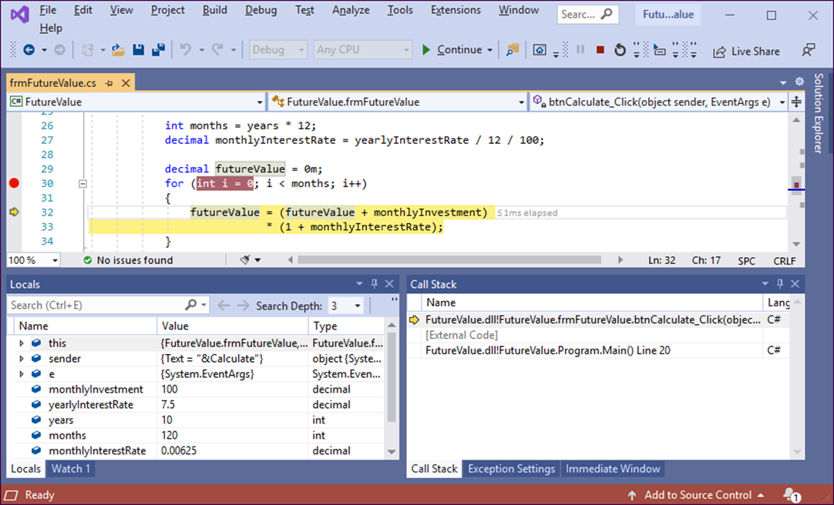
A for loop with a breakpoint and an execution point

Slide 29
How to set and clear breakpoints
To set a breakpoint, click in the margin indicator bar to the left of a statement. Or, press the F9 key to set a breakpoint at the cursor insertion point. Then, a red dot will mark the breakpoint.
To remove a breakpoint, use any of the techniques for setting a breakpoint. To remove all breakpoints at once, use the Delete All Breakpoints command in the Debug menu.
How to work in break mode
In break mode, a yellow arrowhead marks the current execution point, which points to the next statement that will be executed.
To step through your code one statement at a time, press the F11 key or click the Step Into button on the Debug toolbar.
To continue normal processing until the next breakpoint is reached, press the F5 key.

Slide 30
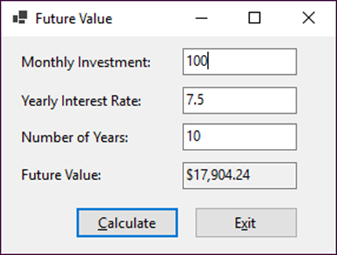
The Future Value form
The property settings for the form
Default name Property Setting
Form1 Text Future Value
AcceptButton btnCalculate
CancelButton btnExit
StartPosition CenterScreen

Slide 31
The property settings for the controls
Default name Property Setting
label1 Text Monthly Investment:
label2 Text Yearly Interest Rate:
label3 Text Number of Years:
label4 Text Future Value:
textBox1 Name txtMonthlyInvestment
textBox2 Name txtInterestRate
textBox3 Name txtYears
textBox4 Name txtFutureValue ReadOnly True TabStop False
button1 Name btnCalculate Text &Calculate
button2 Name btnExit Text E&xit

Slide 32
Additional property settings
The TextAlign property of each of the labels is set to MiddleLeft.
The TabIndex properties of the controls are set so the focus moves from top to bottom and left to right.

Slide 33
The code for the event handlers in the Future Value application
private void btnCalculate_Click(object sender, EventArgs e)
{
decimal monthlyInvestment =
Convert.ToDecimal(txtMonthlyInvestment.Text);
decimal yearlyInterestRate = Convert.ToDecimal(txtInterestRate.Text);
int years = Convert.ToInt32(txtYears.Text);
int months = years * 12;
decimal monthlyInterestRate = yearlyInterestRate / 12 / 100;
decimal futureValue = 0m;
for (int i = 0; i < months; i++)
{
futureValue = (futureValue + monthlyInvestment)
* (1 + monthlyInterestRate);
}
txtFutureValue.Text = futureValue.ToString("c");
txtMonthlyInvestment.Focus();
}
private void btnExit_Click(object sender, EventArgs e)
{
this.Close();
}

Slide 34
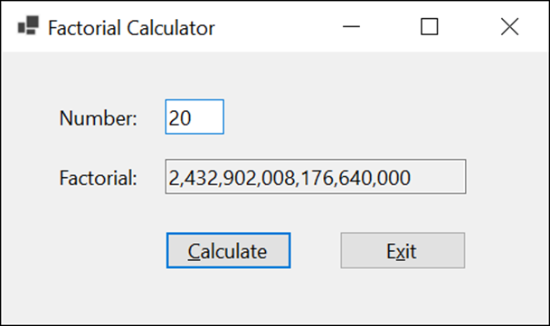
Extra 5-1 Calculate the factorial of a number
Accept an integer and then calculate the factorial of that integer.

Slide 35
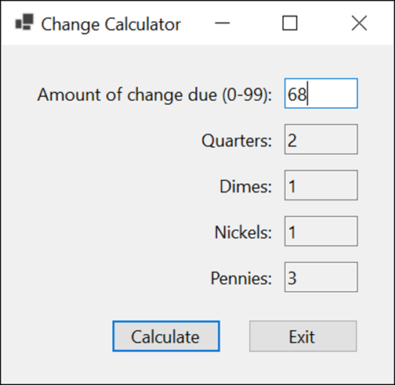
Extra 5-2 Calculate change
Calculate the number of quarters, dimes, nickels, and pennies needed to make change for an amount between 0 and 99 cents.

Slide 36
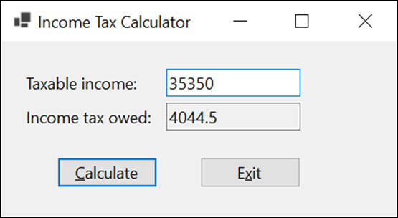
Extra 5-3 Calculate income tax
Calculate the federal income tax owed for a taxable income amount.

Slide 37
Objectives (part 1)
Applied
Given a Boolean expression and the values for the variables in the expression, evaluate the expression.
Use if statements, switch statements, and switch expressions as needed within your applications.
Use while, do-while, and for statements as needed within your applications.
Knowledge
Compare the if-else and switch statements.
Compare the if-else statement and the conditional operator.
Describe the differences between while, do-while, and for loops.
Explain how the break and continue statements work when used within a loop.

Slide 38
Objectives (part 2)
Describe the use of breakpoints, the Locals window, and stepping through code as they apply to debugging errors within loops.
Describe block scope in the context of the control structures.

